Slide 1



COFFEE SHOP SALES
NTI Data Analysis Project
TEAM MEMBERS
Menna tullah gamal | Nourhan roshdi | Mariam Mohssen
Tools: Python | Pandas | Power BI

Slide 2




Project & Dataset Overview
Project Overview
Dataset Columns
Our project focuses on analyzing coffee shop sales data and preparing it for further advanced analysis and visualization.
Transaction Info: transaction_id, date, time
Store Info: store_id, store_location
Product Info: product_id, category, type, detail
Dataset Overview
Sales Info: transaction_qty, unit_price
Transactions: 149,116
Tools Used
Columns: 11
Time Period: Jan 1, 2023 – Jun 30, 2023
Python Pandas Power BI

Slide 3



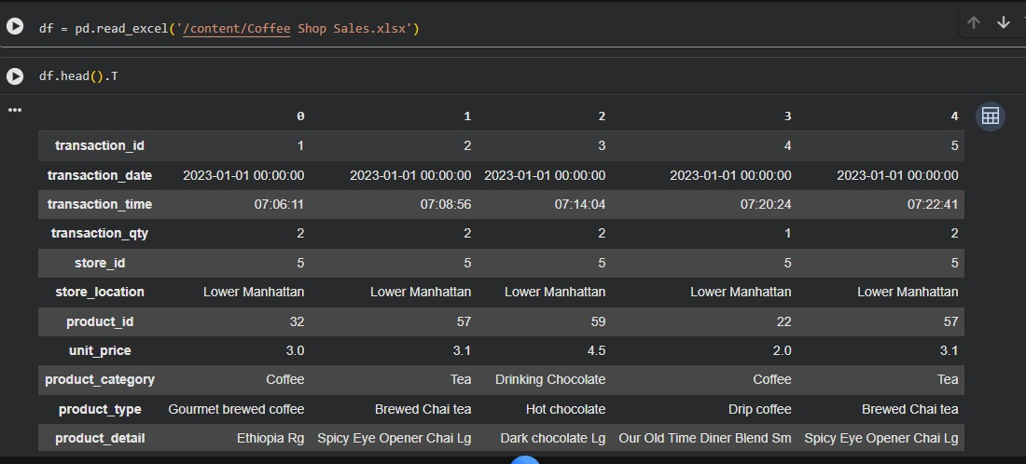



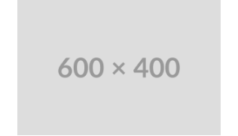
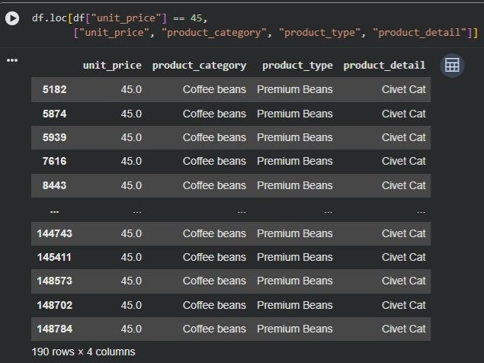
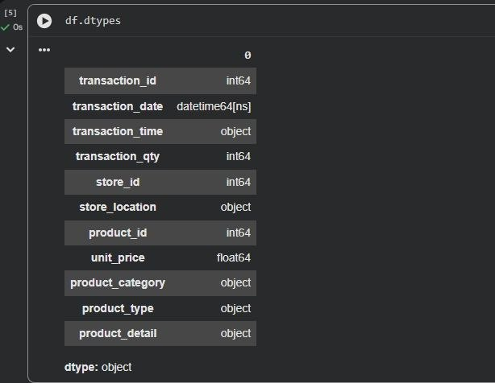
Cleaning & Initial Validation
The dataset was carefully checked for data quality, consistency, and unusual values before proceeding with analysis.
① Initial Dataset
② Unusual Value Check
③ Data Type Check
df.head().T
Before — Original Dataset Inspection.
Highest unit price ($45) investigated and confirmed valid (Premium Civet Cat Beans).
df.dtypes
Before — Initial Data Types Validation.
Data Quality Results:
Missing Values: None Duplicate Records: None Data Types: Validated

Slide 4


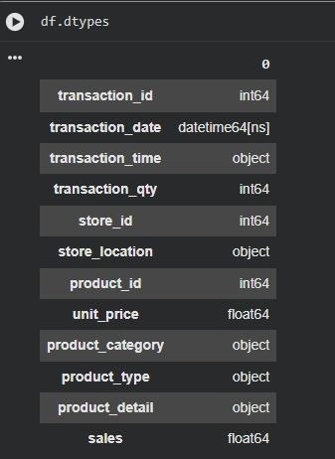

Sales Preparation & Check
④ Sales Calculation
A new Sales column was created by multiplying the transaction quantity by the unit price to support further analysis and visualization.
Sales = transaction_qty × unit_price
Final Data Quality Check
Missing Values: None
Duplicate Records: None
Data Types: Validated
Unusual Unit Price: Investigated & Confirmed Valid

Slide 5




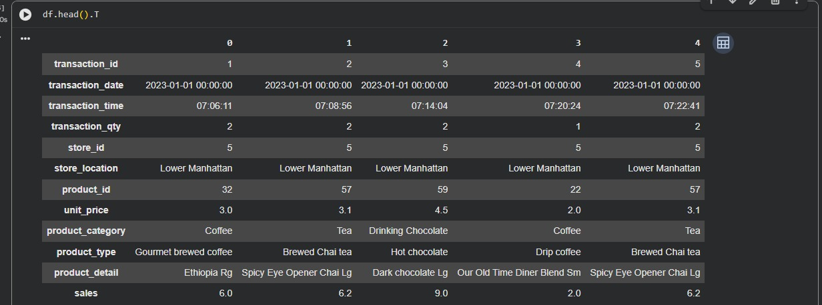
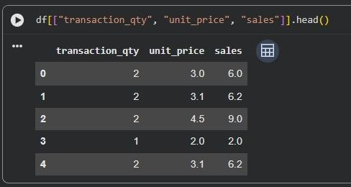

Final Data Validation
Dataset After Sales Column Addition
Final Data Types Validation
df.head().T
Confirming successful addition of the metric.
df.dtypes
Validating float64 format for the Sales column.
Final Preparation Result
The dataset was successfully cleaned, validated, and prepared for analysis and visualization in Power BI.

Slide 6
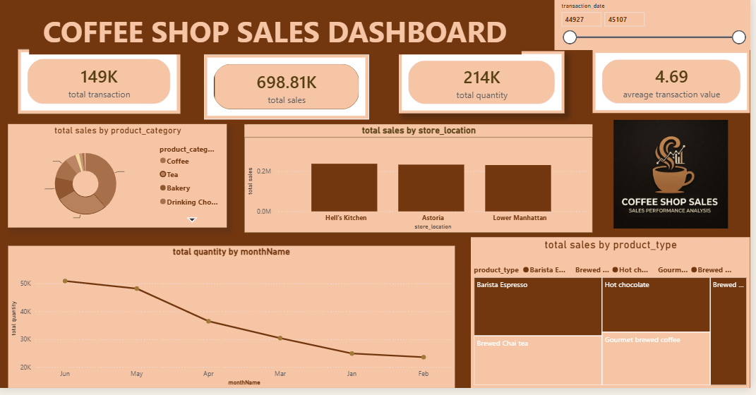
x
The dataset was successfully cleaned, validated, and prepared for analysis and visualization in Power BI.

Slide 7
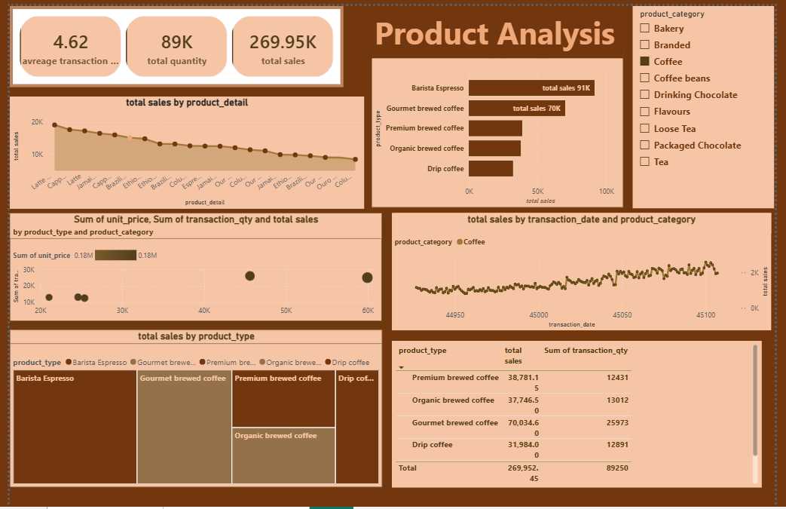
The dataset was successfully cleaned, validated, and prepared for analysis and visualization in Power BI.

Slide 8
Key Insights
Sales are growing over time. A few products drive most of the sales. Sales peak during specific hours and days. Store performance varies by location.
Recommendations
Focus on best-selling products. Increase staff during peak hours. Promote low-performing products. Maintain stock for high-demand items.

Slide 9
Thank you

